Slide 1

Project Report on
Secure Boot
In
Embedded Systems
Guided By: Submitted By:
Mr. Arif B Kapil Kumar - 230940130033
Sanket Patil - 230940130052
Diwakar Varansai - 230940130022
Amey Raghatate - 230940130010

Slide 2
SECURE BOOT IN EMBEDDED SYSTEMS

Slide 3
OVERVIEW
Hashing
Encryption
Digital Signature
Digital Certificate
General Boot Flow
Beagle bone Black Boot Flow
Secure Boot Flow
RISC-V Boot Flow

Slide 4
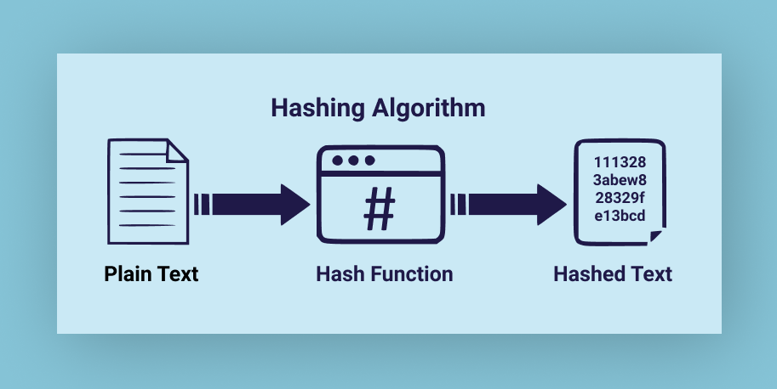

Slide 5
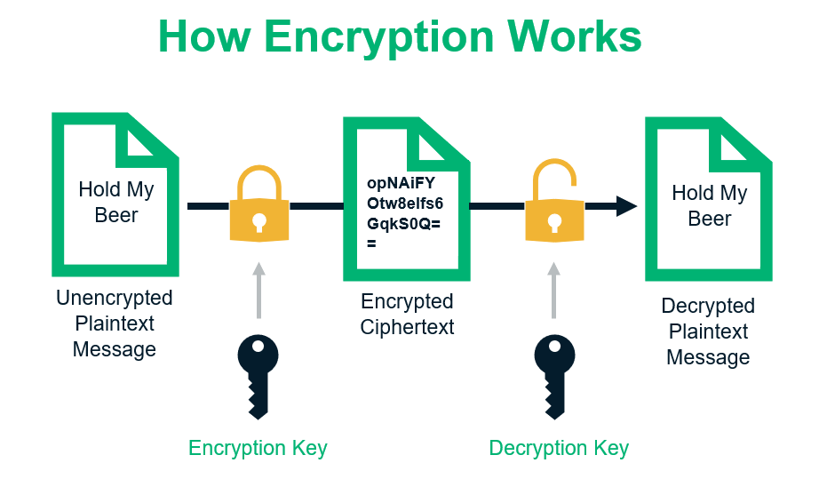

Slide 6
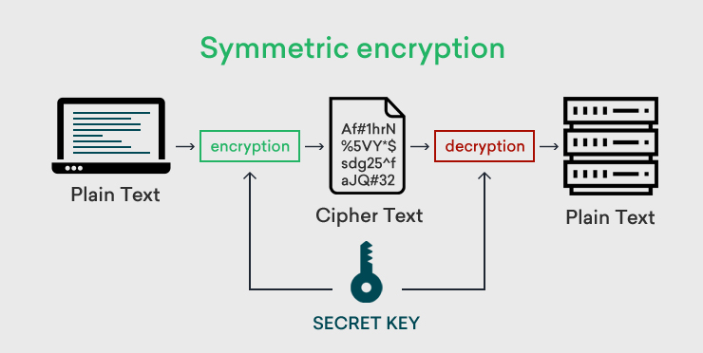
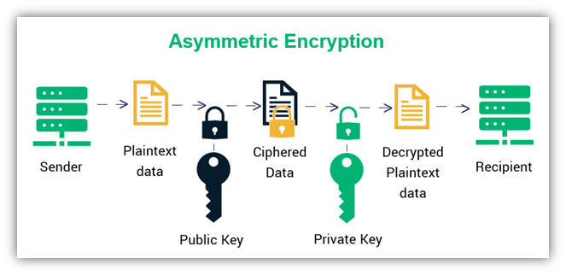

Slide 7
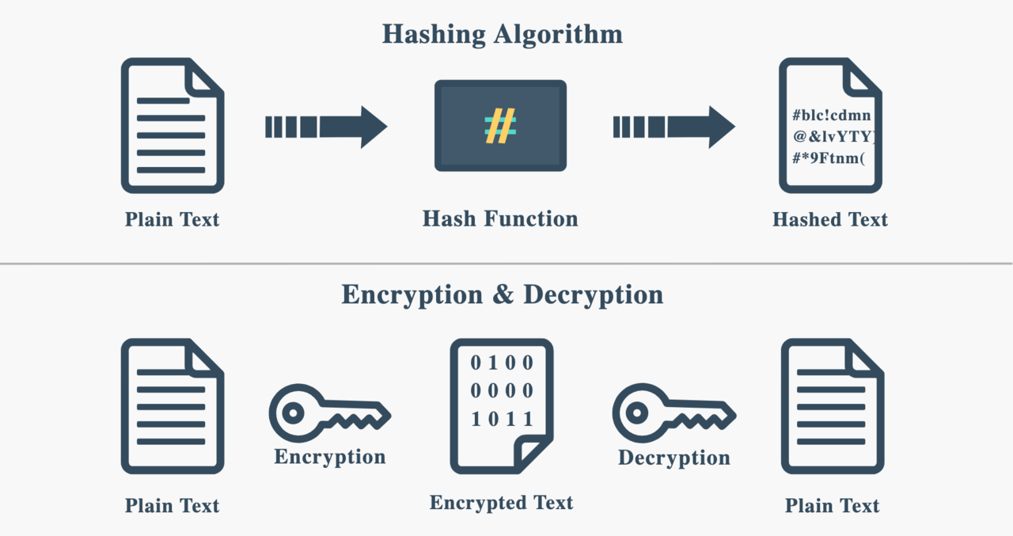

Slide 8
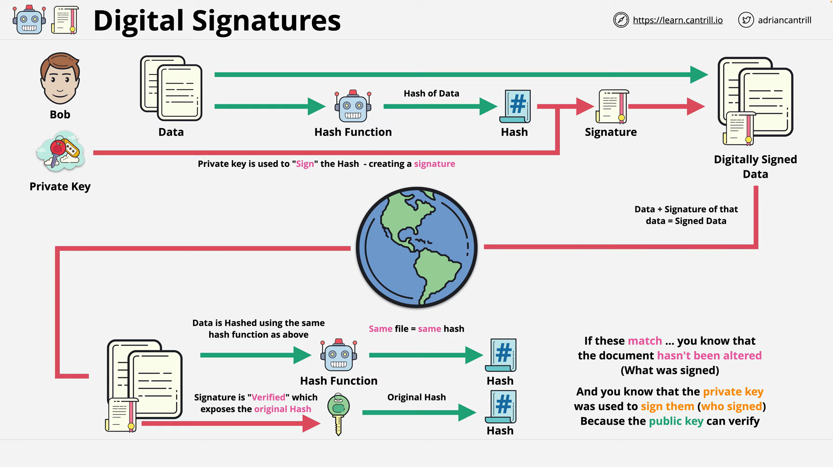

Slide 9
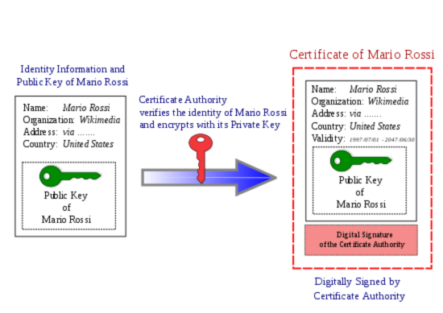
Digital Certificates

Slide 10
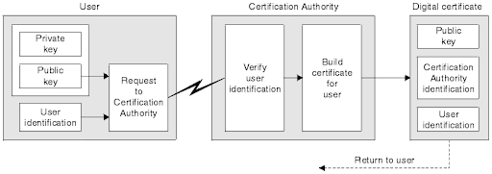
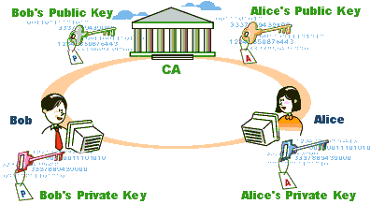

Slide 11
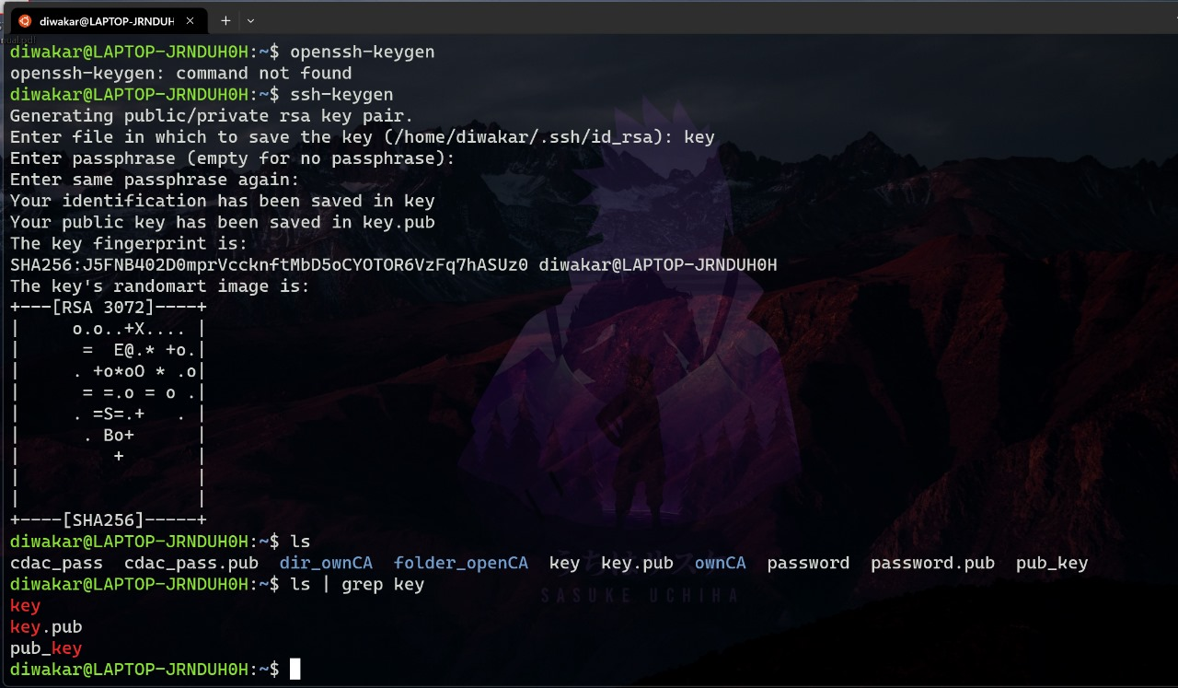
OPENSSL Key Generation:

Slide 12
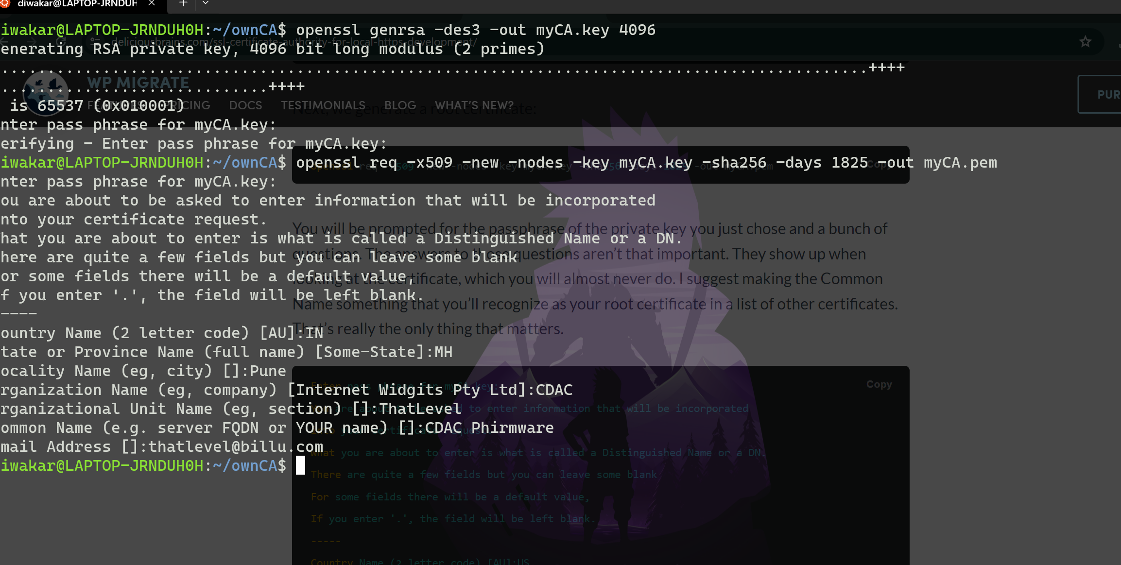
Self Signed Certificate:

Slide 13
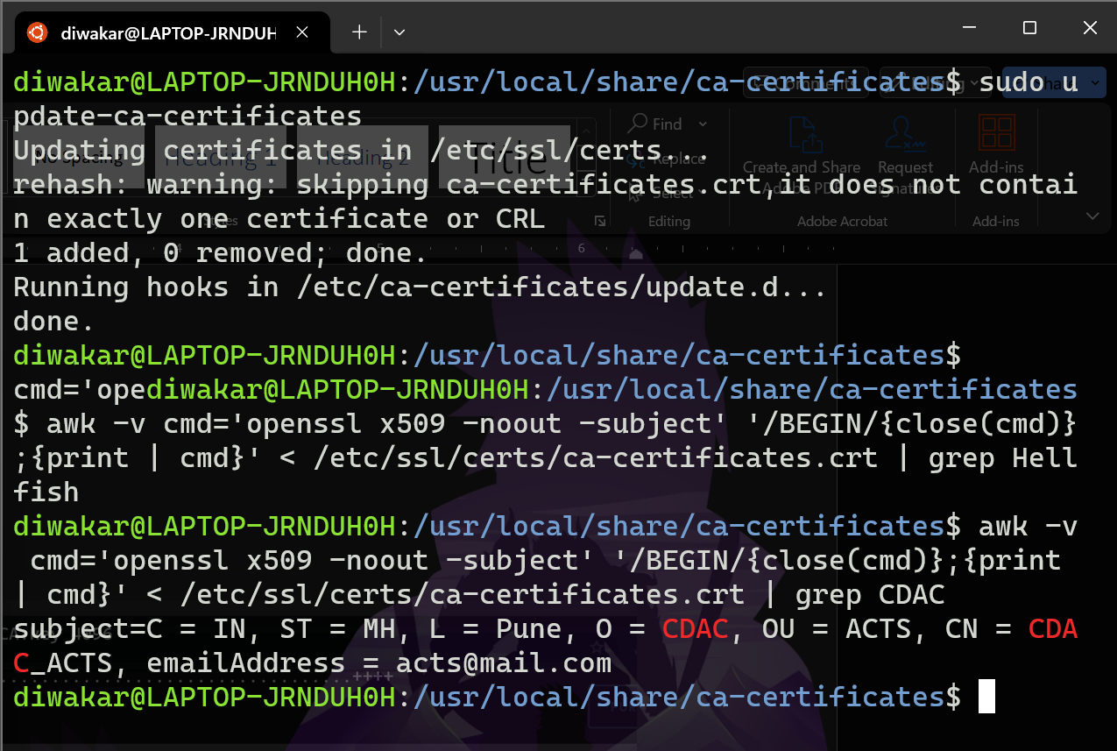
Update & Verifying Self Signed Certificate :

Slide 14
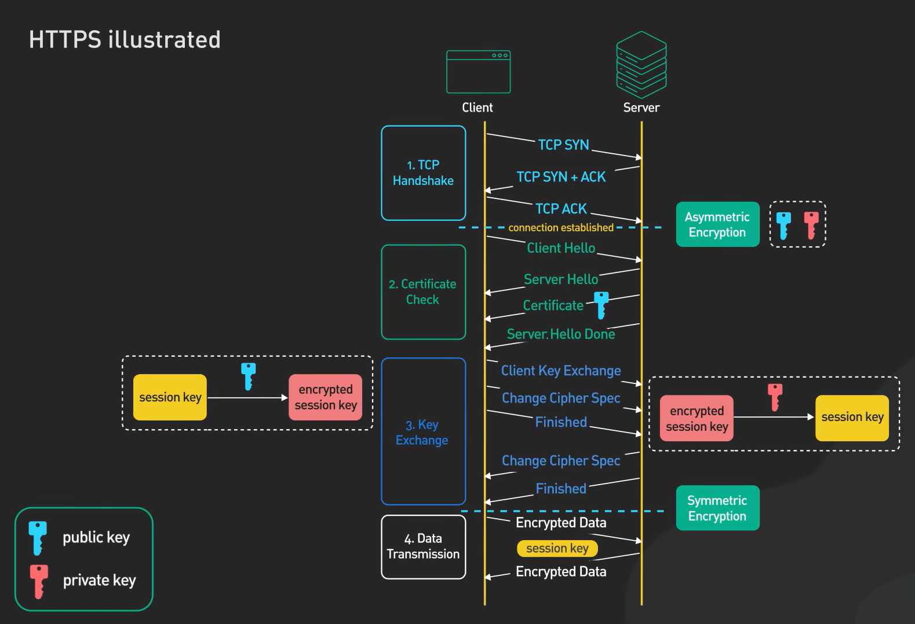
TLS Handshake :

Slide 15
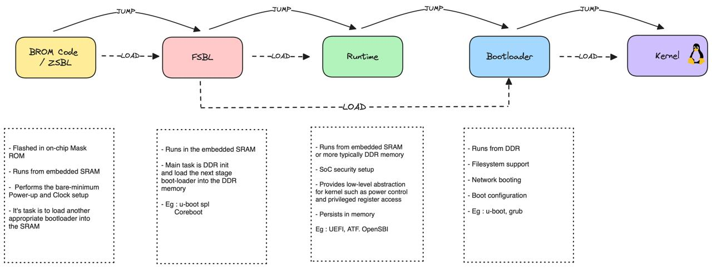
General Boot Flow

Slide 16
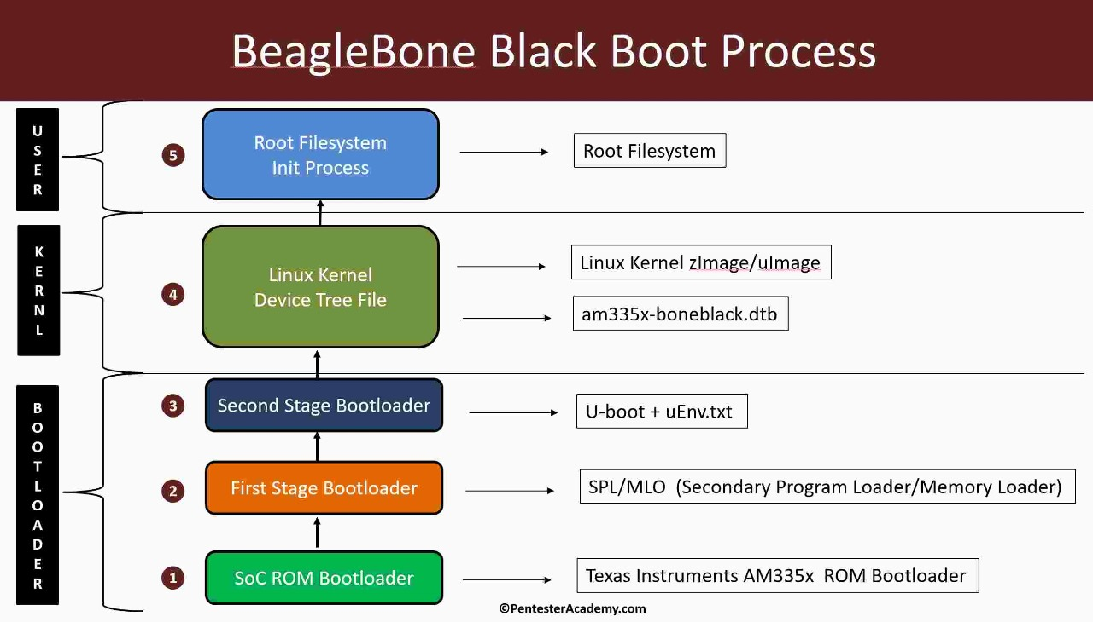

Slide 17
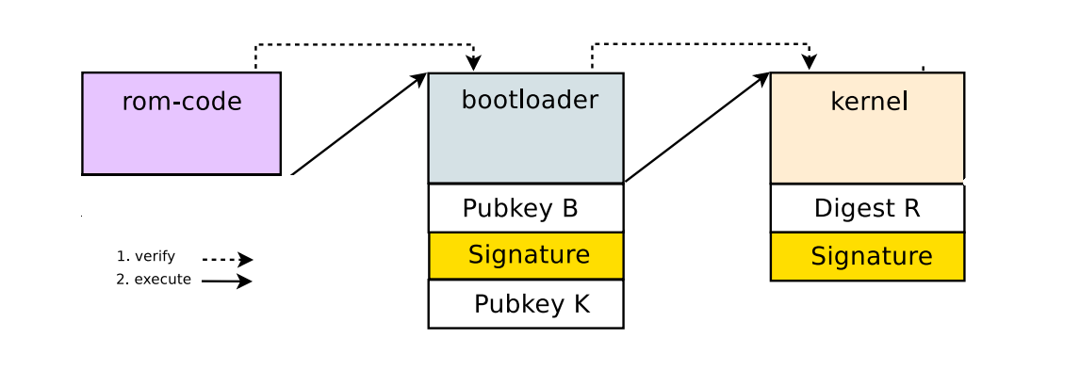
Secure Boot Flow :

Slide 18
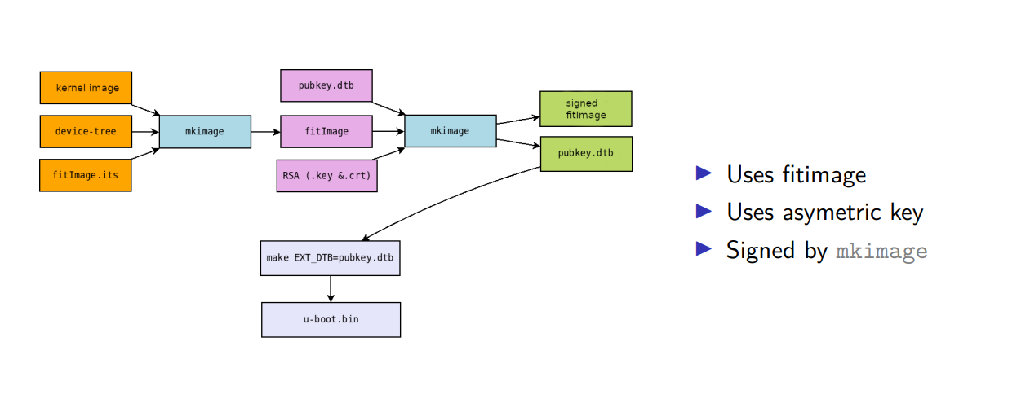
Kernel & Device-Tree Signing Flow Chart

Slide 19
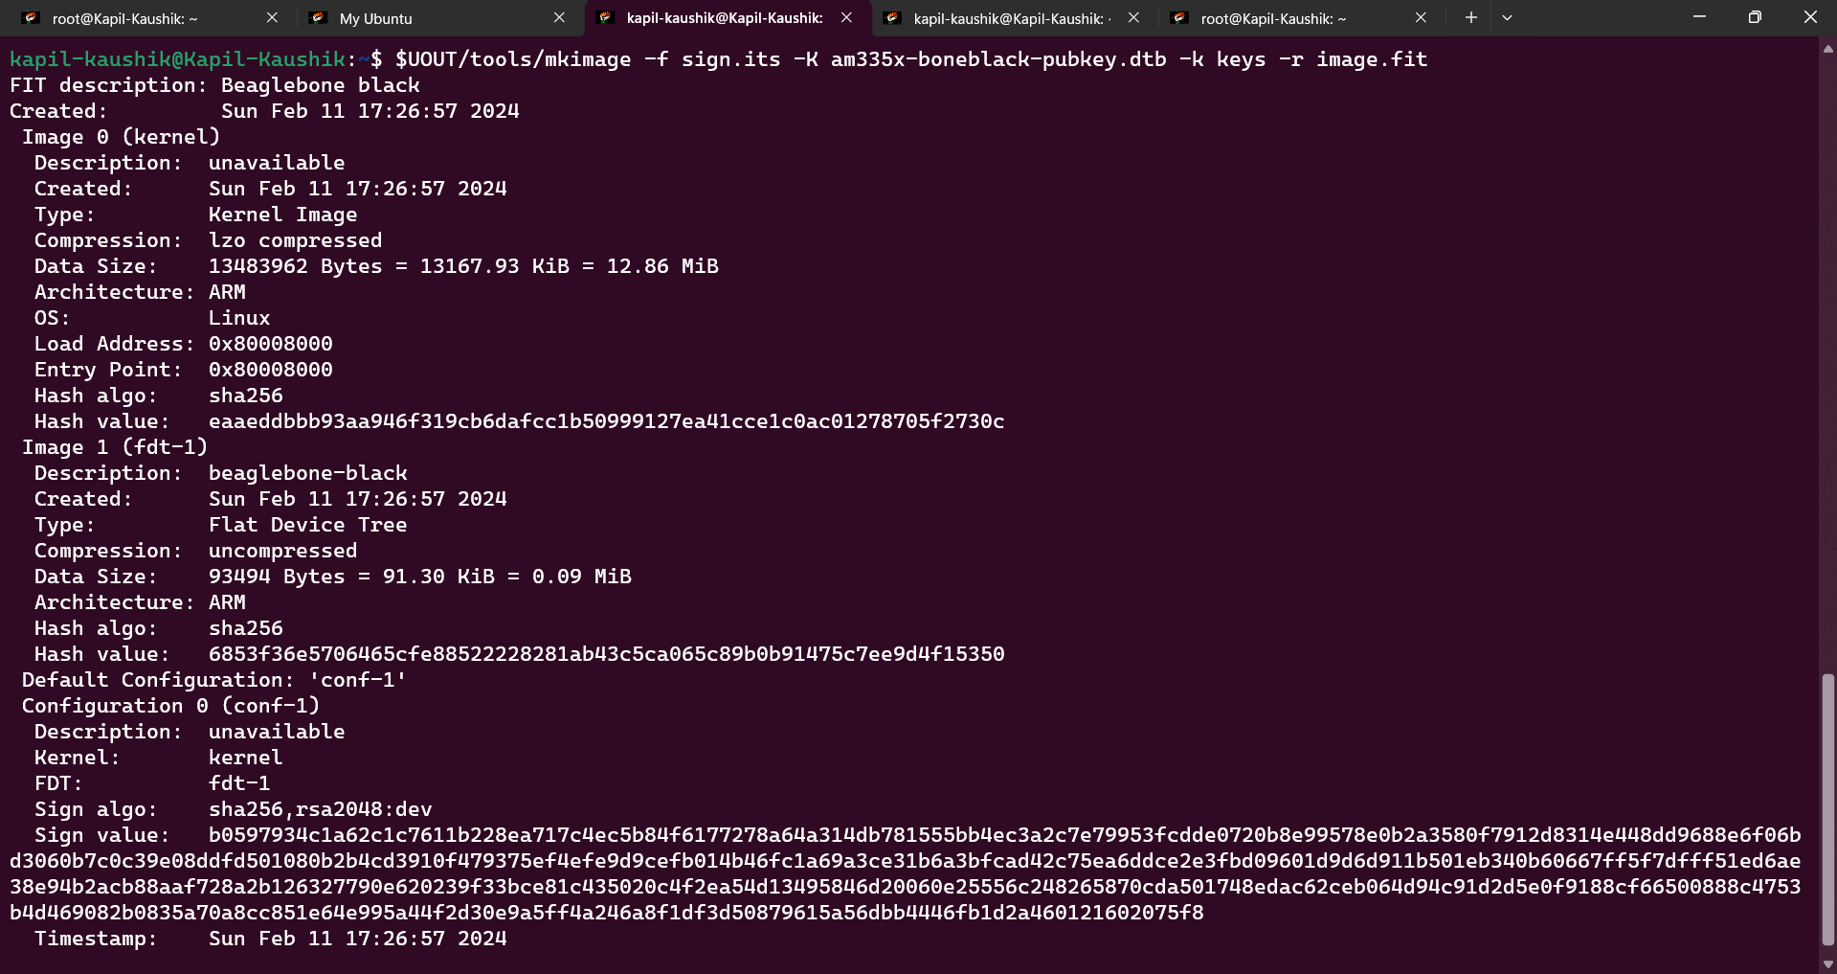
Signing Kernel

Slide 20
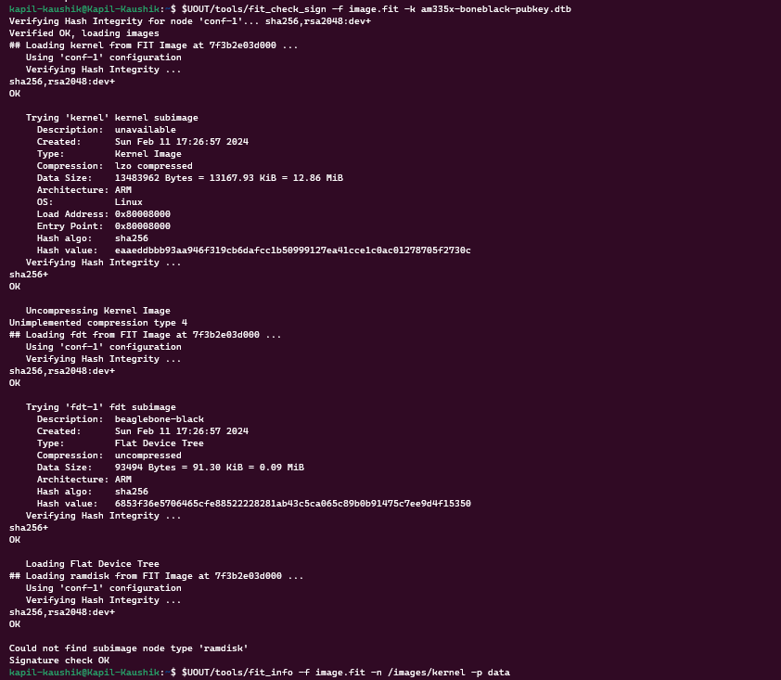
Verifying Kernel with Public Key & Signature

Slide 21
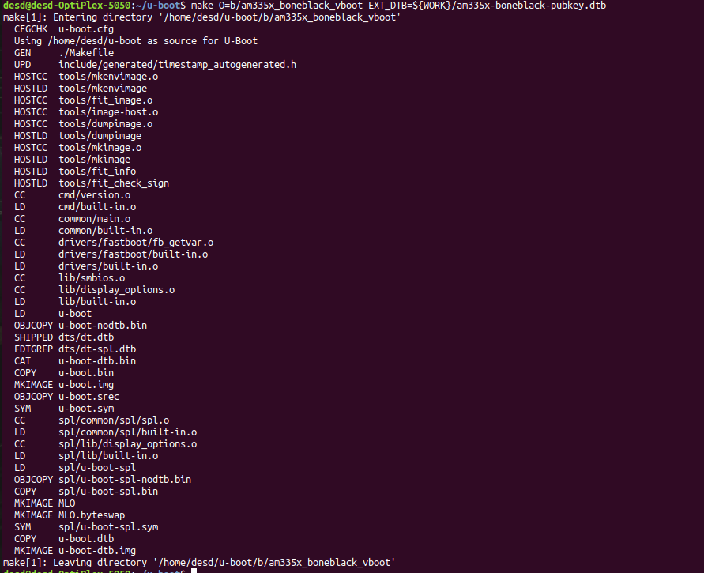
Placing Public Kay in U-boot Device Tree

Slide 22
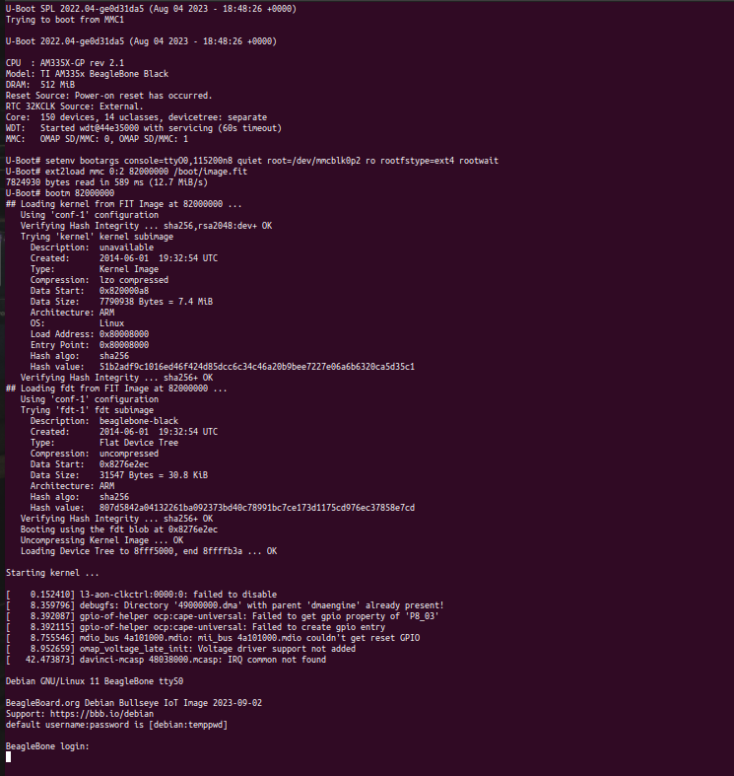
Beagle bone Board Booting

Slide 23
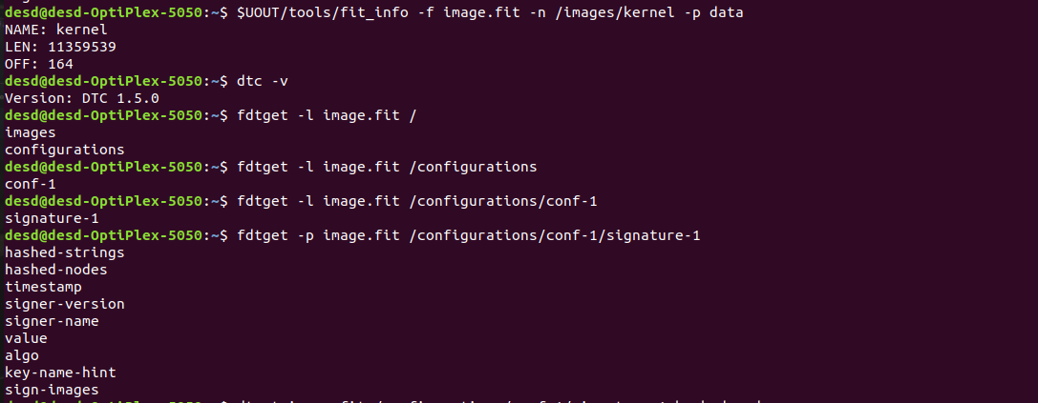
Checking Configurations of image.fit file

Slide 24
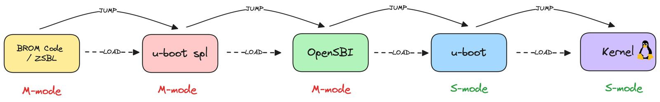
RISC-V Boot Flow

Slide 25
Thank You

